Slide 1
Introduction to
Shared Canvas and IIIF Technologies
COST/IRHT Training School:
TRANSMISSION OF TEXTS: NEW TOOLS, NEW APPROACHES
April 2, 2014
Benjamin Albritton, Stanford University Libraries

Slide 2
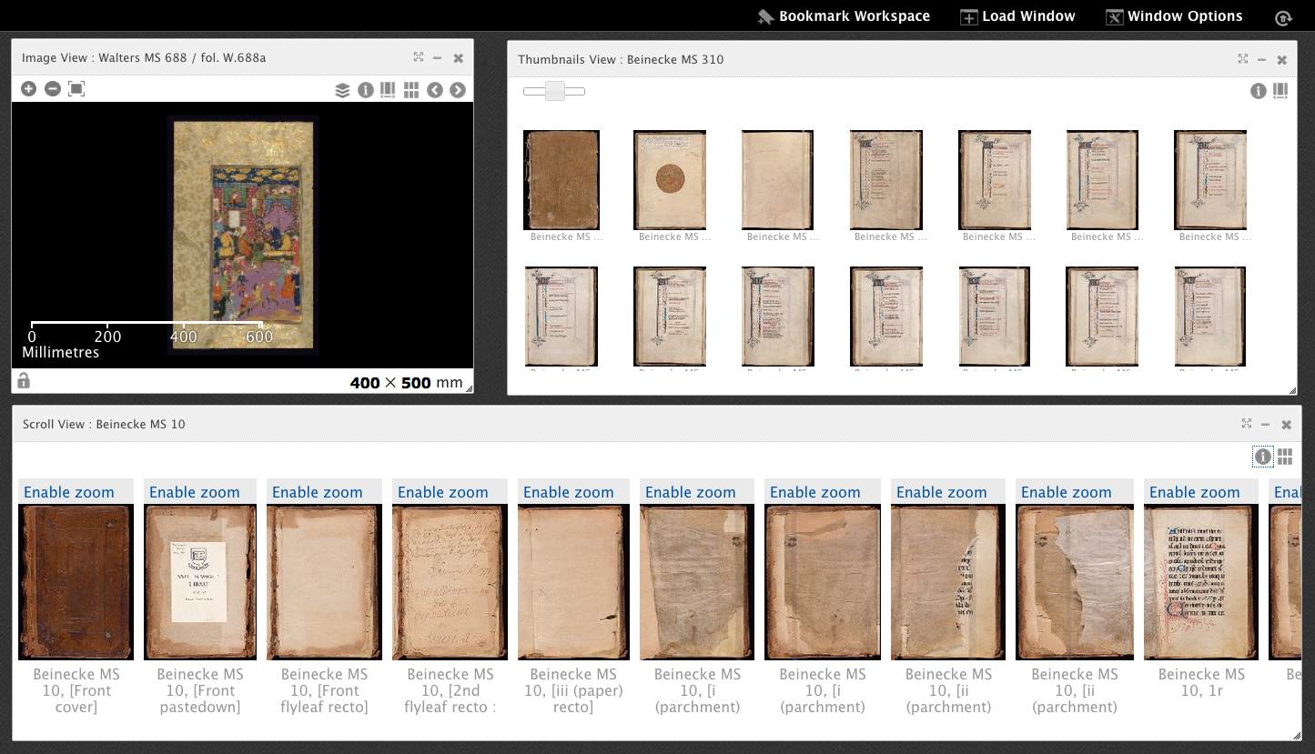
Imagine being able to study manuscripts…

Slide 3
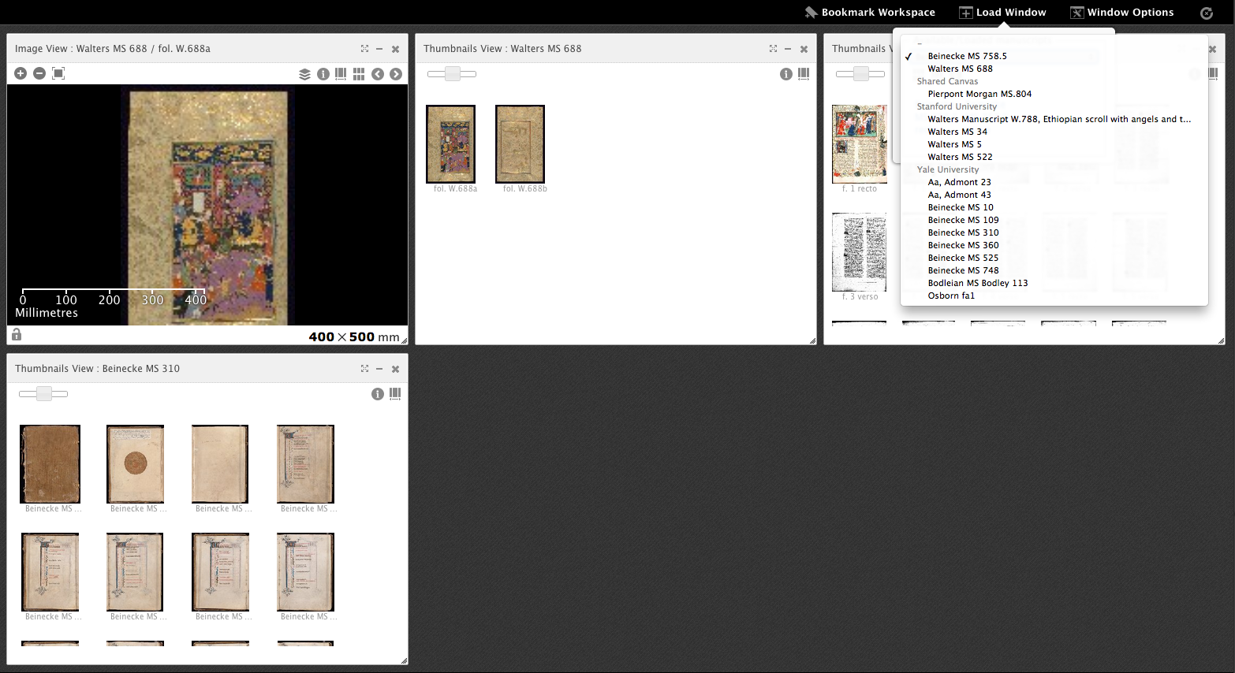
With content from any repository…

Slide 4
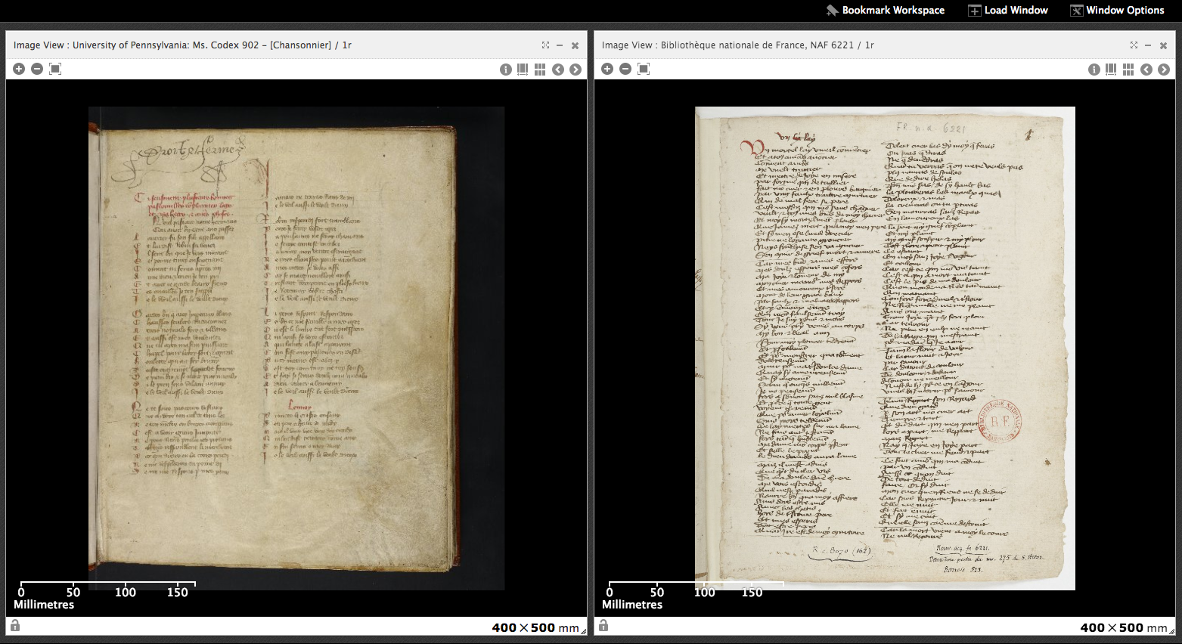
So that scholars can compare…

Slide 5
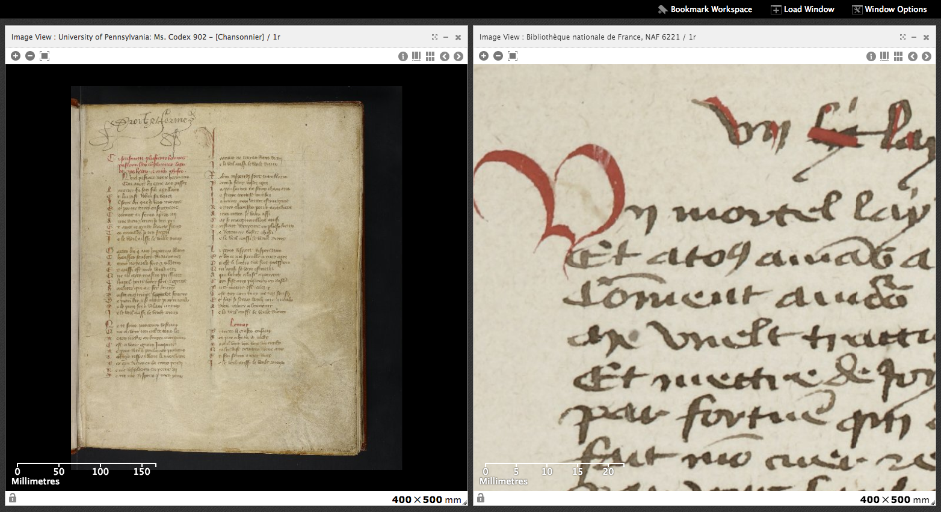
And investigate in detail…

Slide 6
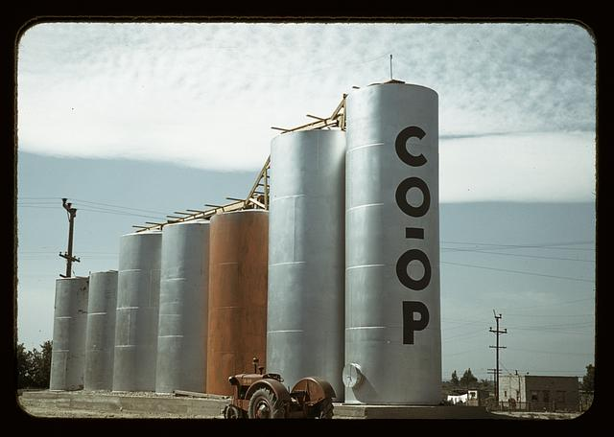
Welcome to Silo-ville
Grain elevators, Caldwell, Idaho, by Lee Russell, 1941. http://www.loc.gov/pictures/resource/fsac.1a34206/

Slide 7
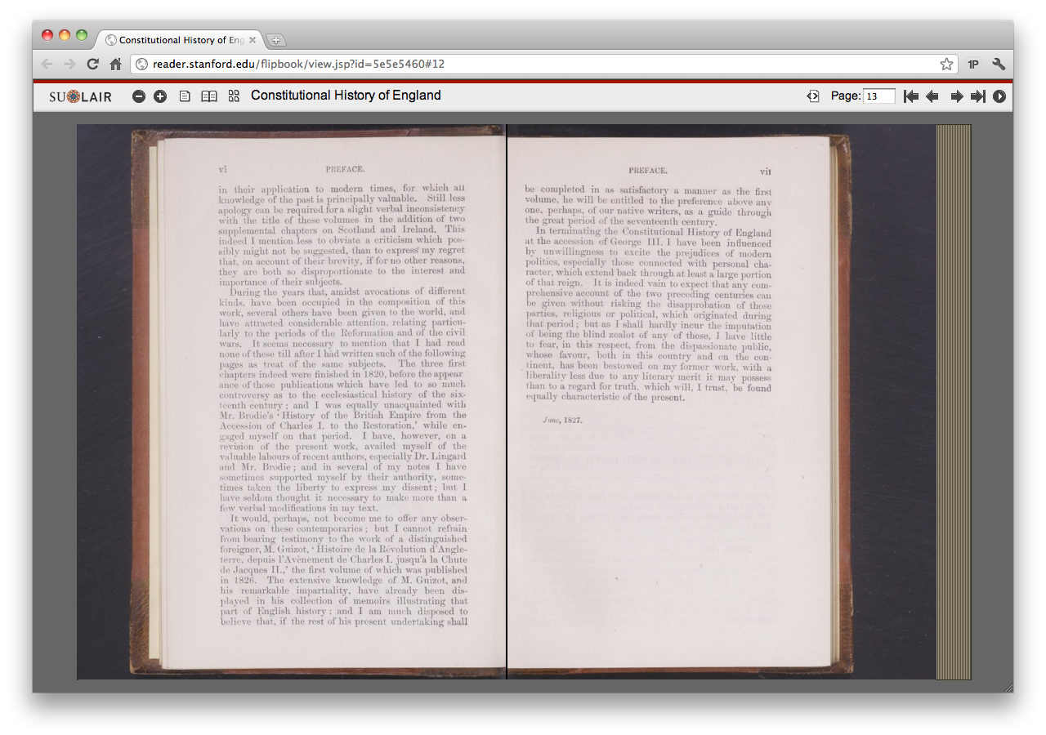
Stanford University
Notes:
Stanford’s Book Reader (based on the Internet Archive book reader).

Slide 8
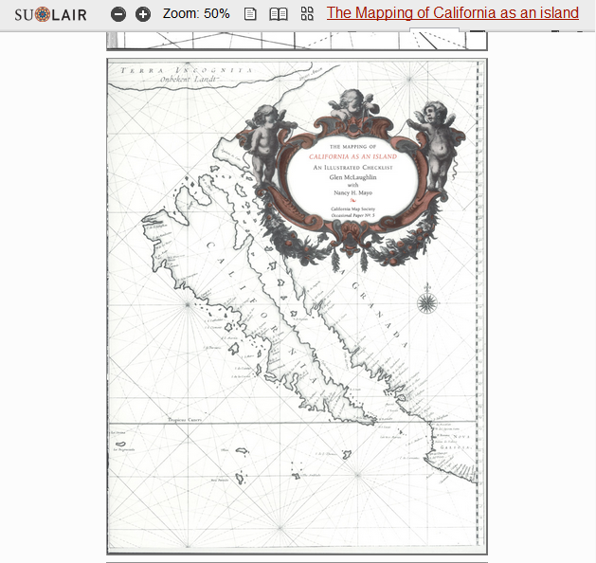
Stanford University
Notes:
Stanford map viewer.

Slide 9
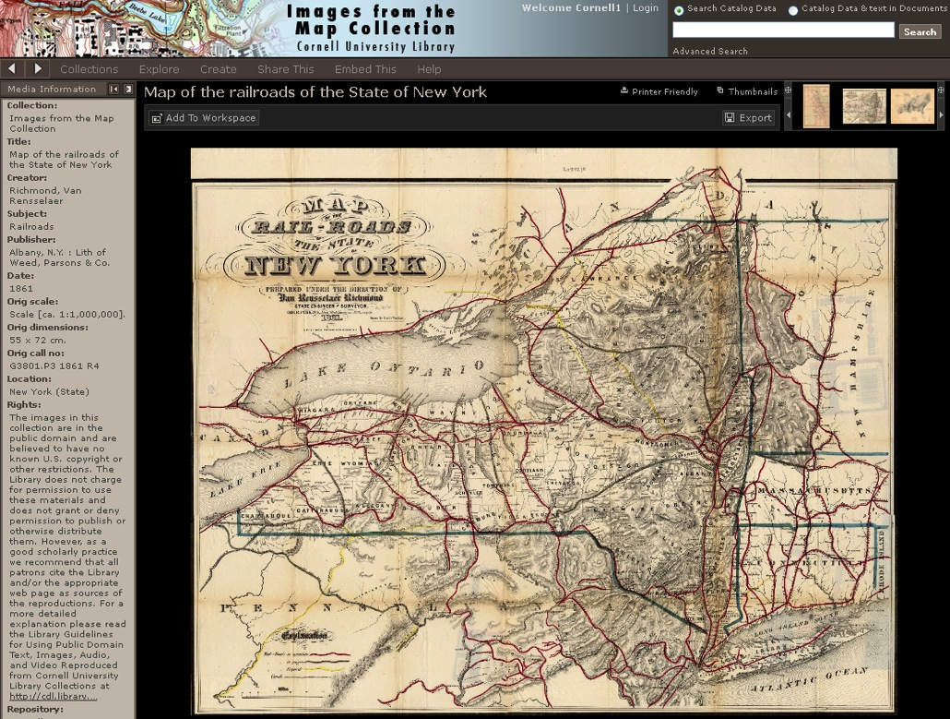
Cornell University
Notes:
Cornell map viewer.

Slide 10
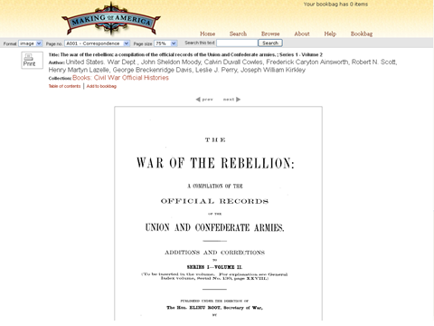
Cornell University
Notes:
Cornell book reader (based on DLXS)

Slide 11
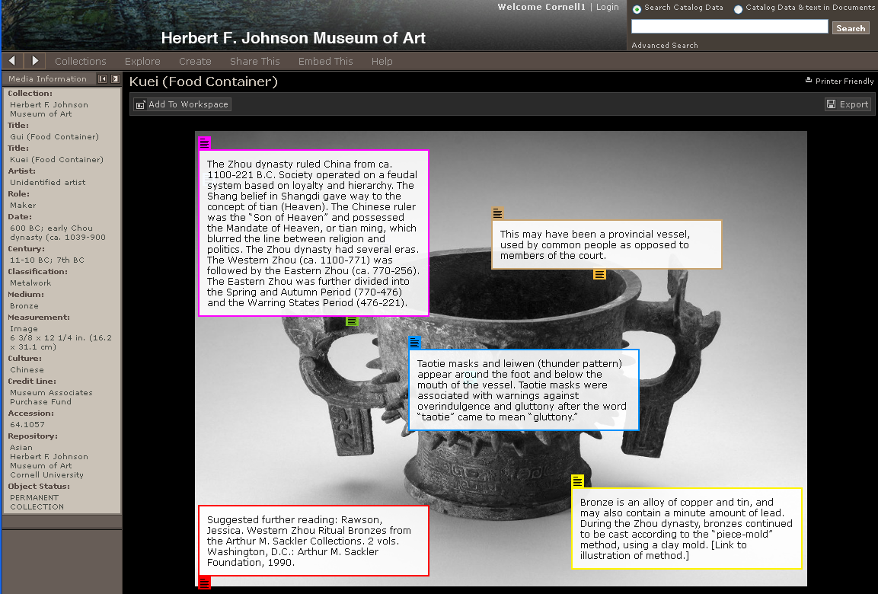
Cornell University
Notes:
Cornell annotated art collection, hosted in Luna.

Slide 12
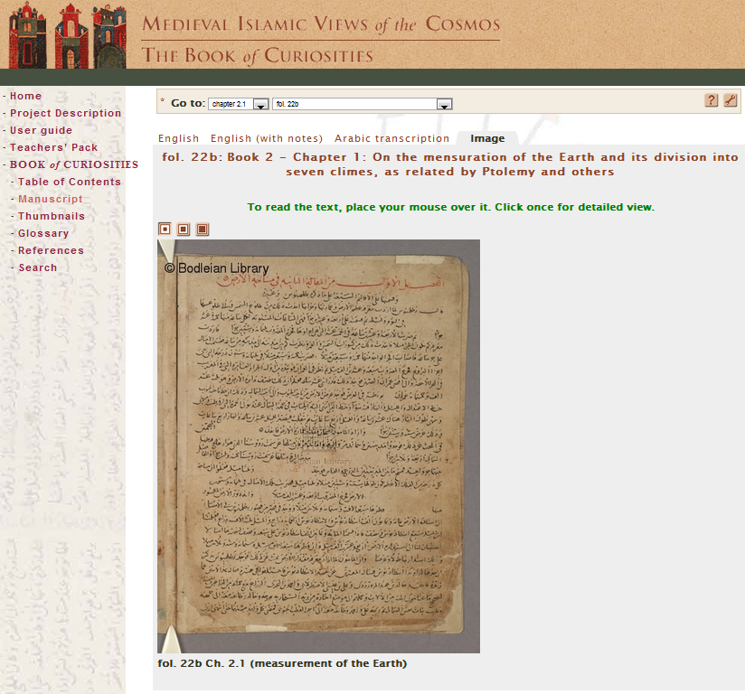
Bodleian Libraries
Notes:
Oxford one-off manuscript viewer.

Slide 13
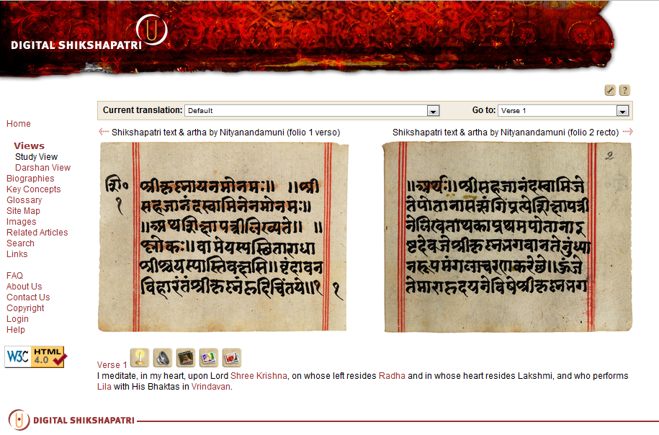
Bodleian Libraries
Notes:
Oxford one off viewer.

Slide 14
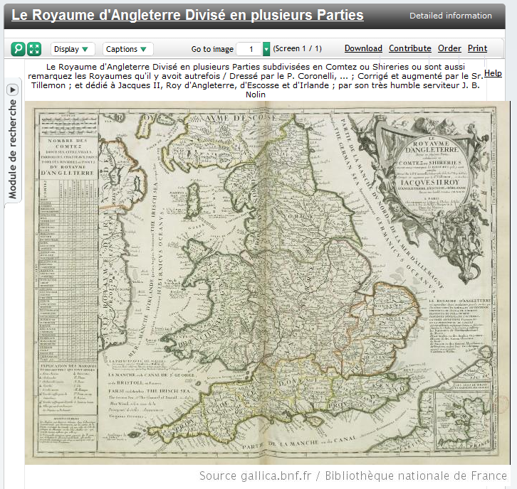
Bibliothèque nationale de France
Notes:
Gallica from BnF

Slide 15
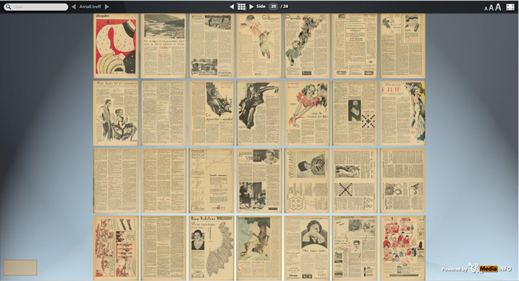
National Library of Norway
Notes:
MediaInfo newspaper viewer from Nat’l Library of Norway.

Slide 16
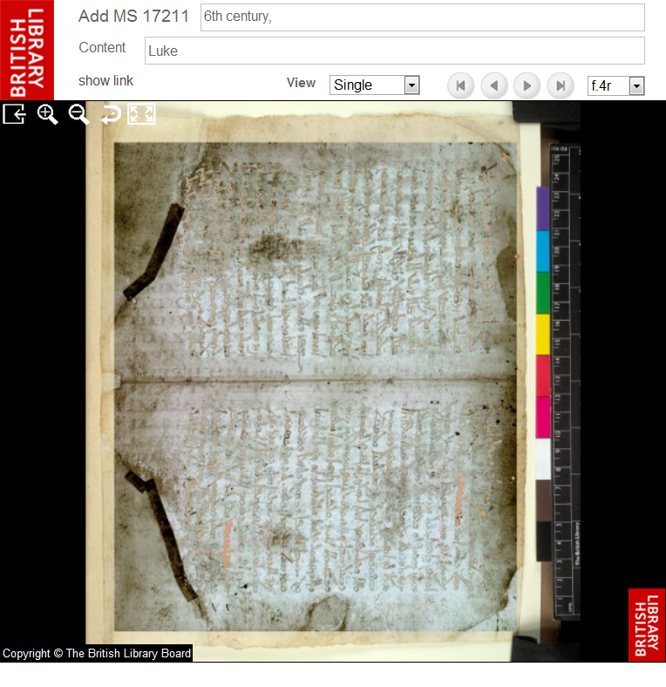
British Library
Notes:
British Library MSS viewer.

Slide 17
A World of Silos & Duplication
Every repo a silo (→ no interoperability)
Every app a one-off (→overhead to code and keep)
Every user forced to cope (→ many UIs, little integration)
Notes:
The repositories and applications providing access to Digital Medieval Manuscripts in today’s environment are heavily silo’ed, with access to each repository provided through one off applications. This is a microcosm of the wider world of access to image based scholarly resources.

Slide 18
Distinct Concerns
Build useful
tools and apps
Want: Users & resources
Scholars
Tool Makers
Find, Use,
Analyze, Annotate
Want: Mix & Match, Best of Breed
Repositories
Host, Preserve (and Enrich) Resources
Want: Use of Resources, Enriching services, Enriched content
Notes:
The repositories and applications providing access to Digital Medieval Manuscripts in today’s environment are heavily silo’ed, with access to each repository provided through one off applications. This is a microcosm of the wider world of access to image based scholarly resources.

Slide 19
APIs Enable Reuse
Notes:
API’s to access image and description from a repository enable access to content from other applications and systems for viewing or analytics (transcription, annotation, e.g.) Some of this data could be reimported to the repository for reuse by others (e.g., transcriptions).

Slide 20
APIs -> Framework -> Ecosystem
Notes:
If multiple repositories supported the same API’s for access to images, metadata and annotations, one can envision the beginnings of a framework with shared application code across different sites, and interoperable image-based resources, enabling simultaneous access to multiple scholarly repositories through a single interface.

Slide 21
Summary: 2010-2014
Funding from Andrew W. Mellon Foundation
Initial meeting of scholars and curators – Paris, 2010
Digital Manuscript Technical Working Group – 2010-pres.
  Data Model: SharedCanvas
  Data Sharing Framework: IIIF (International Image Interoperabiity Framework)

Slide 22
Interoperability – One Definition
Primary Goal:
  Image and metadata sharing across collections and institutions
“Killer app”:
  a single viewer that reads content from multiple repositories

Slide 23
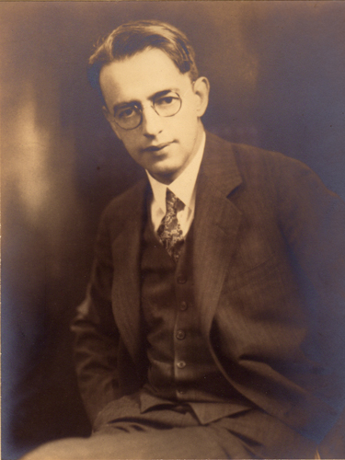
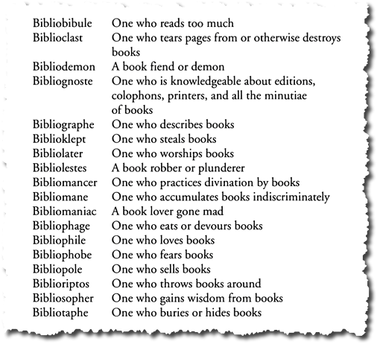
Otto Ege - Biblioclast

Slide 24
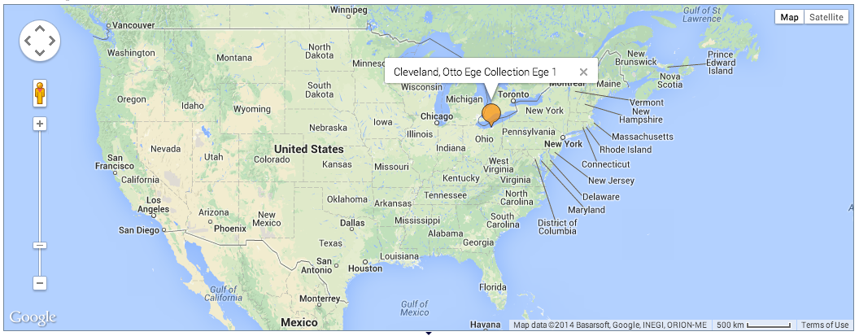
Otto Ege, MS 1 - 1940
Notes:
Noted biblioclast Otto Ege owned a glossed bible, likely French 12th century

Slide 25
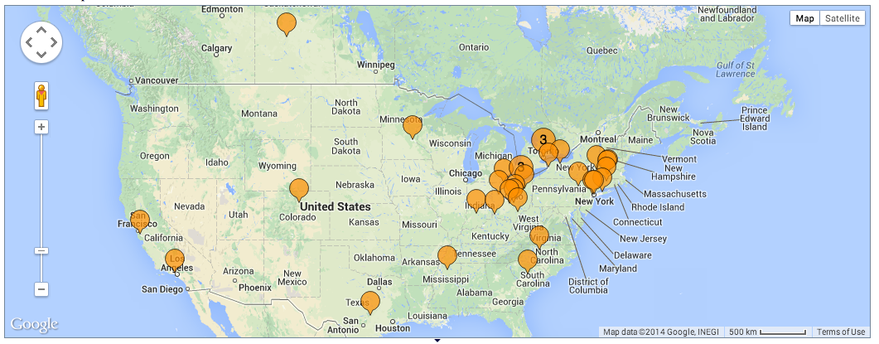
Otto Ege, MS 1 - 2014
Notes:
He broke up the manuscript in the 40s and 50s to include in one of his manuscript leaf portfolios, which were then sold throughout North America. In the intervening years, many leaves have appeared in collections, but many have also gone missing. We can identify 33 separate institutions owning pieces of this manuscript currently – but there are more institutions and individuals out there that have bits.

Slide 26
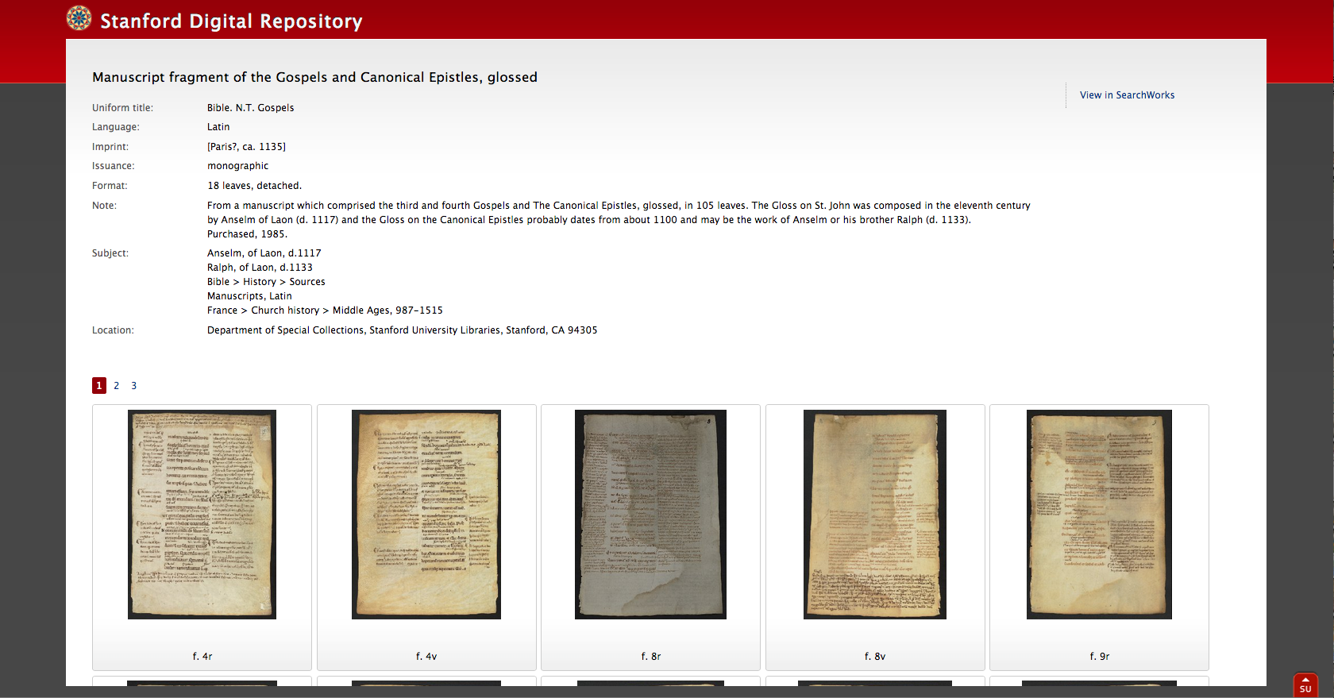
Stanford Leaves of Ege MS 1
MISC 0305 - http://purl.stanford.edu/kq131cs7229

Slide 27
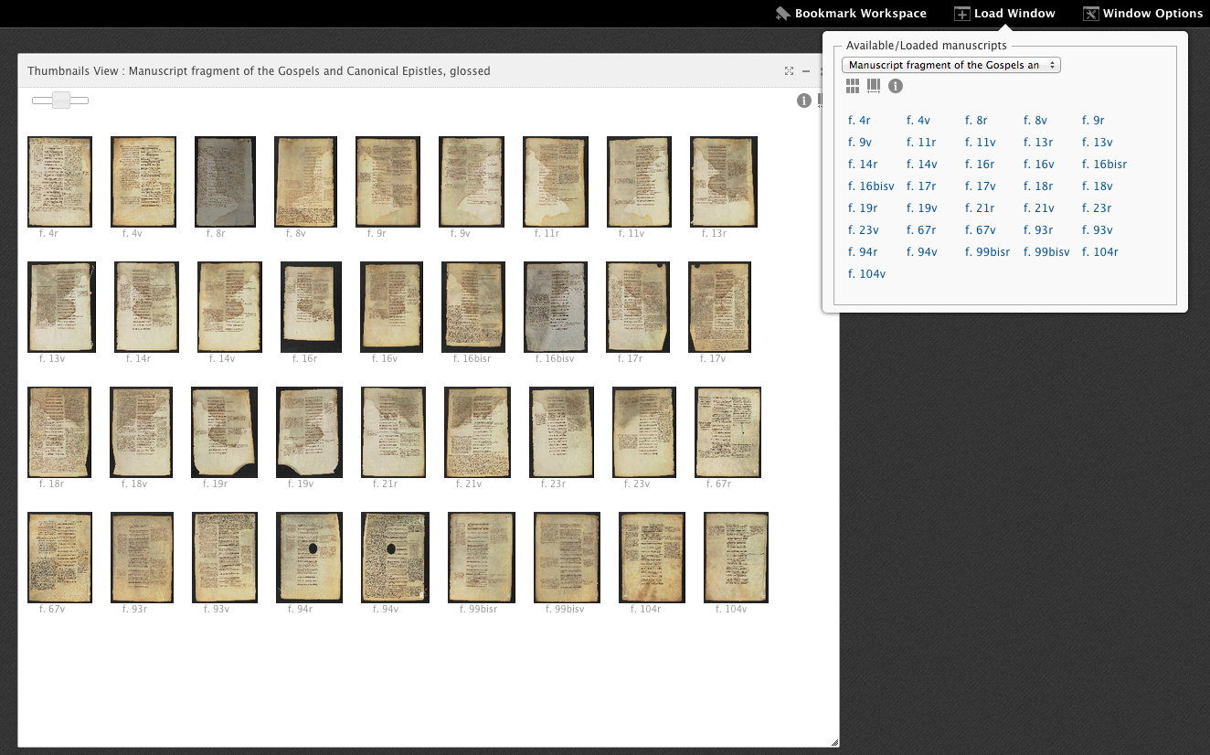
Stanford Leaves of Ege MS 1
http://guillaumedemachaut.com/mirador/index_ege.html
Notes:
18 leaves, not previously recognized as belonging to the Ege book until Albritton began working on them in late 2013

Slide 28
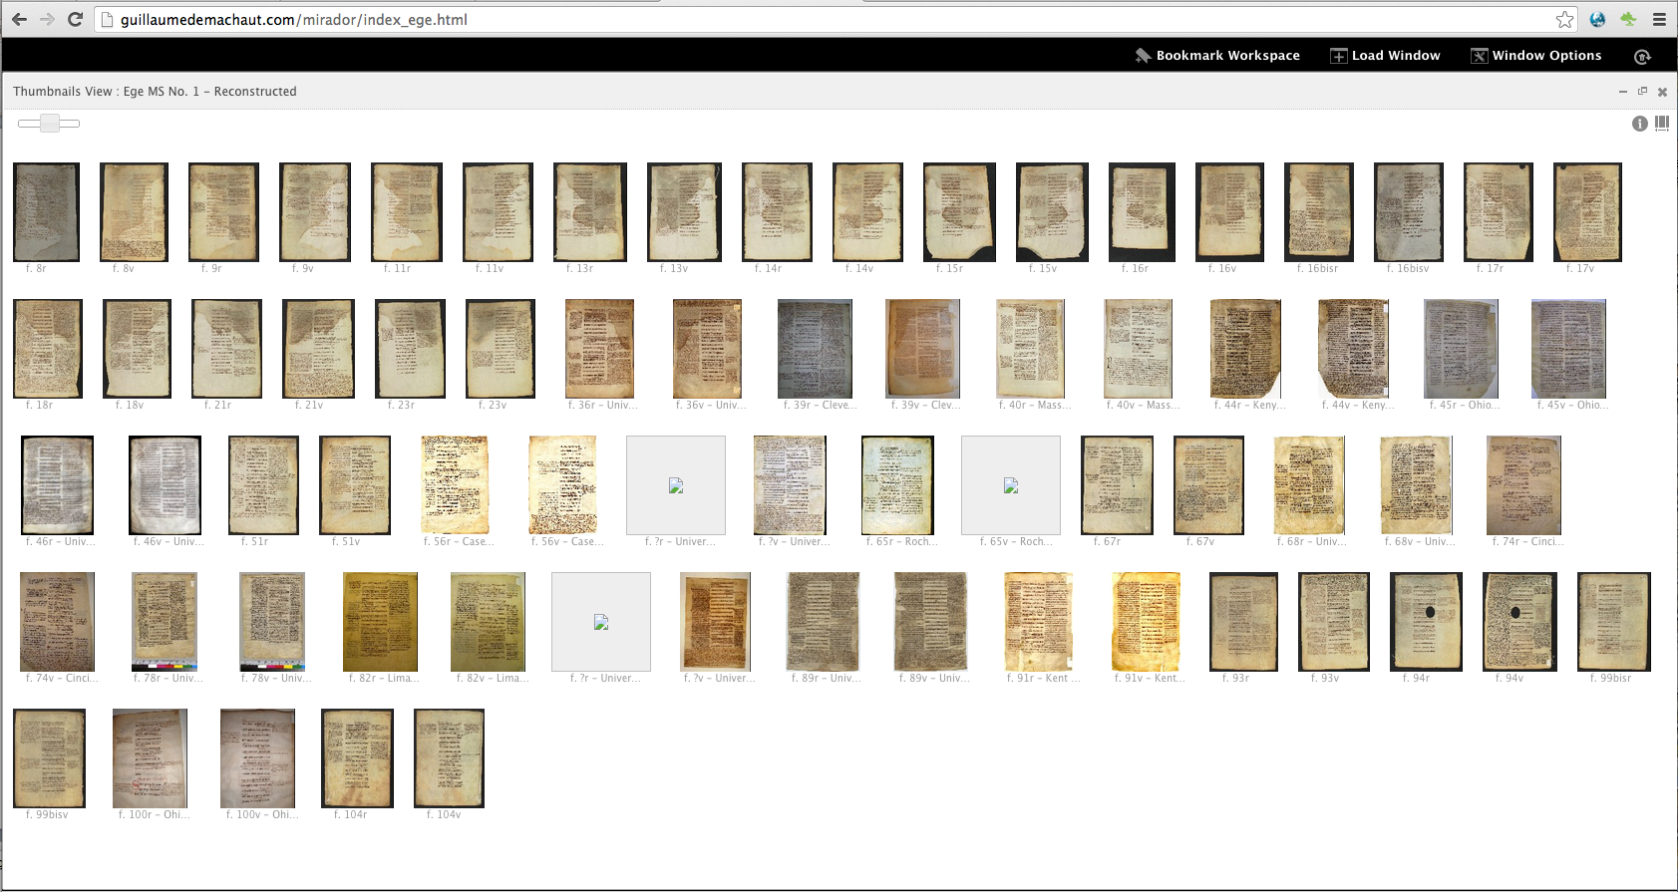
Partial Reconstruction of Ege MS 1
Notes:
16 institutions – each serving their own image

Slide 29
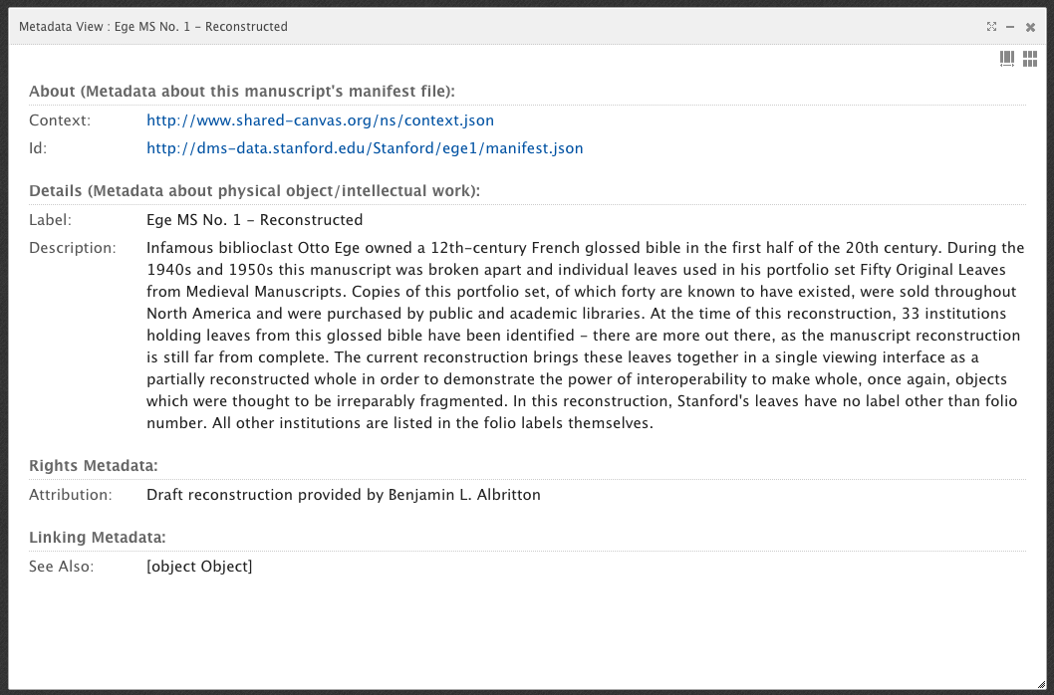
Reconstruction Data
Notes:
Ability to add information to the full reconstruction – including more detailed descriptive metadata… minimally represented here

Slide 30
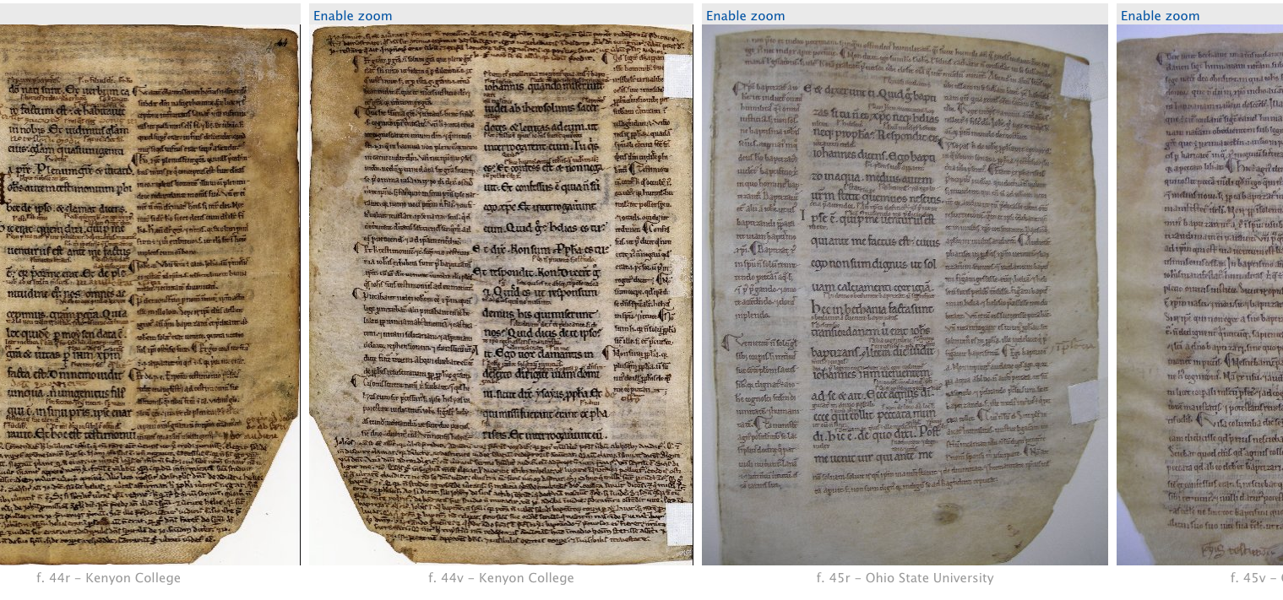
Facing pages from different institutions
Notes:
In a continuous scroll view

Slide 31
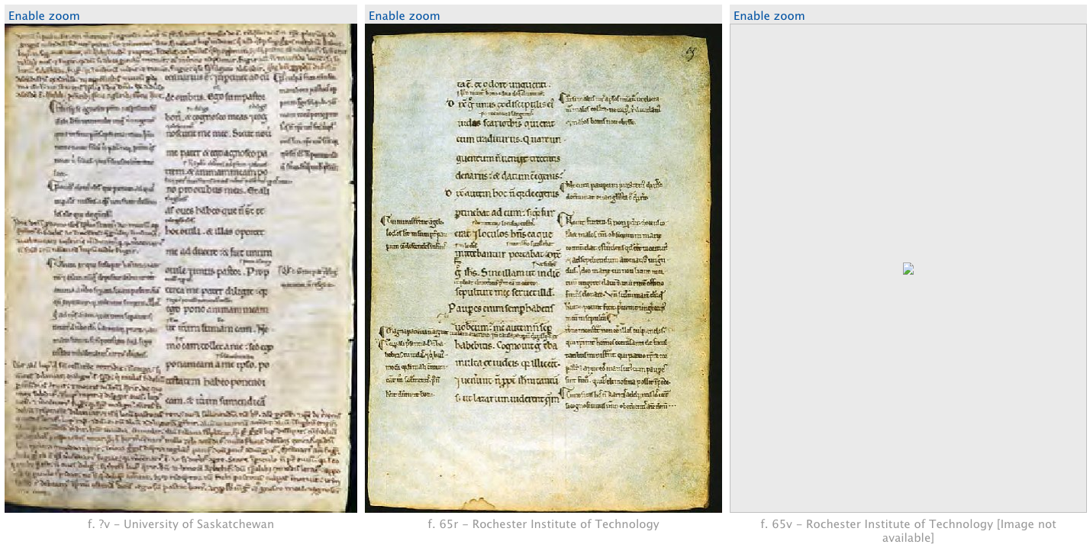
Even when some images are missing

Slide 32
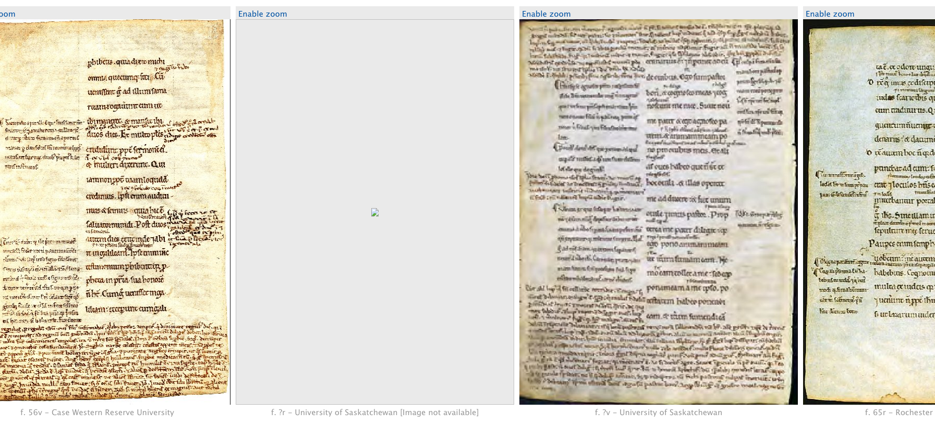
… or even if we’re not sure of the exact foliation
Fol. 56
Fol. ?
Fol. 65
Notes:
The Saskatchewan leaf falls somewhere between fol. 56 and fol. 65, but at the time of reconstruction we were not sure exactly where in that range.

Slide 33
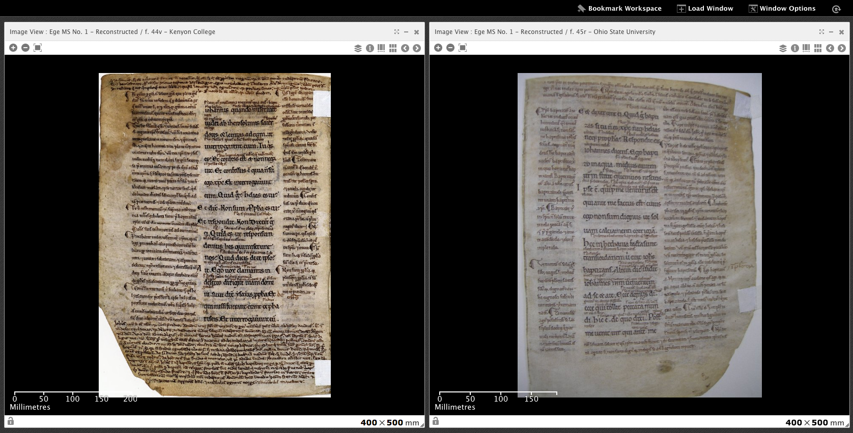
Detailed comparison between pages from different institutions
Notes:
Two images – one from Kenyon College, the other from Ohio State University

Slide 34
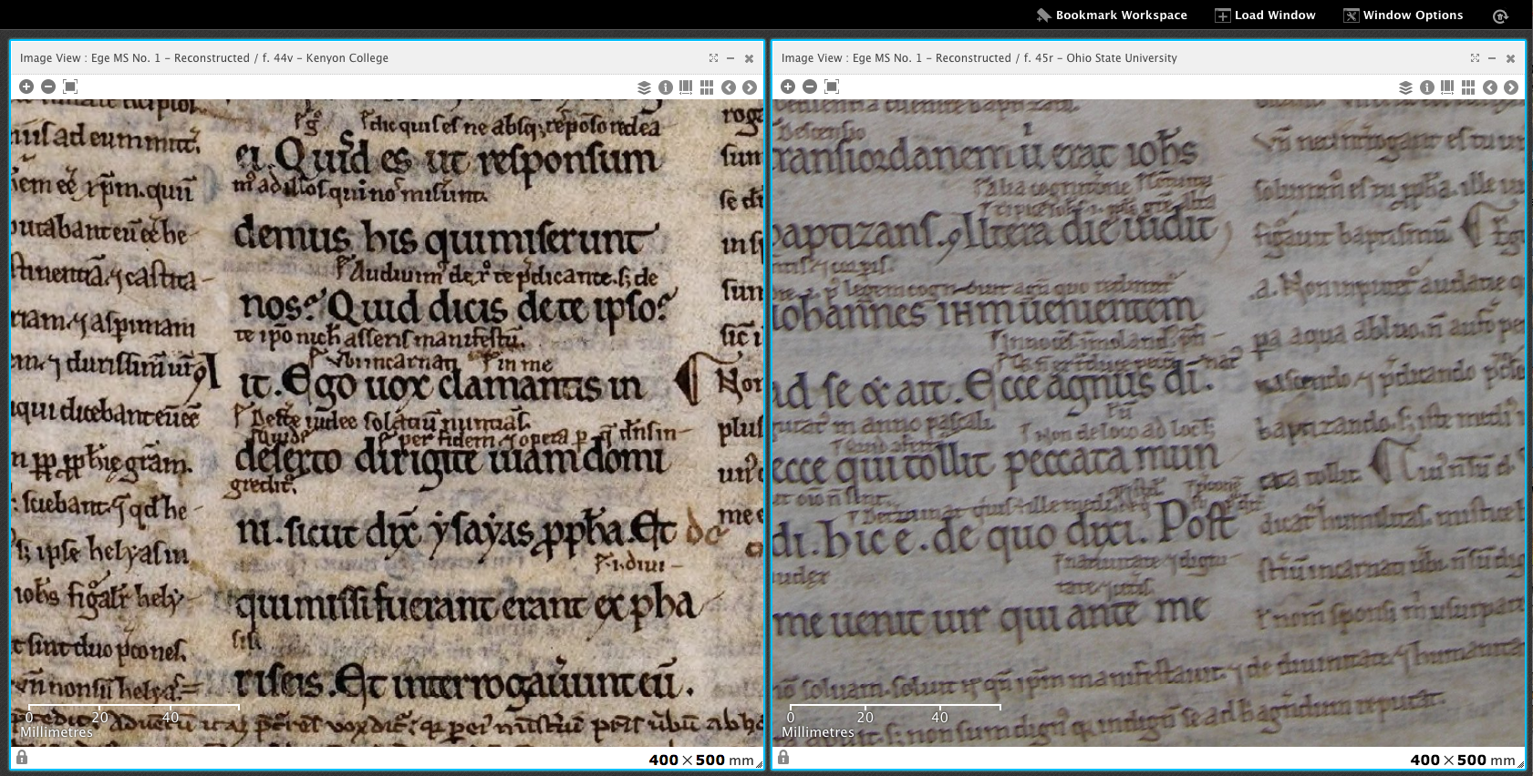
… allowing locked zooming and comparison of details
Notes:
We can compare features from images provided by different institutions – to the detail of the letter

Slide 35
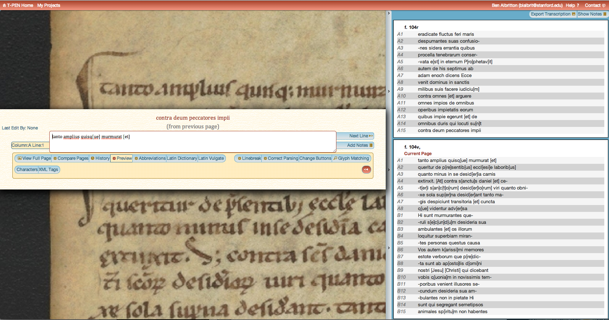
… and use of tools for transcription and annotation
Notes:
Within months, the ability to bring those transcriptions and annotation into the reconstruction viewing environment will be possible…

Slide 36
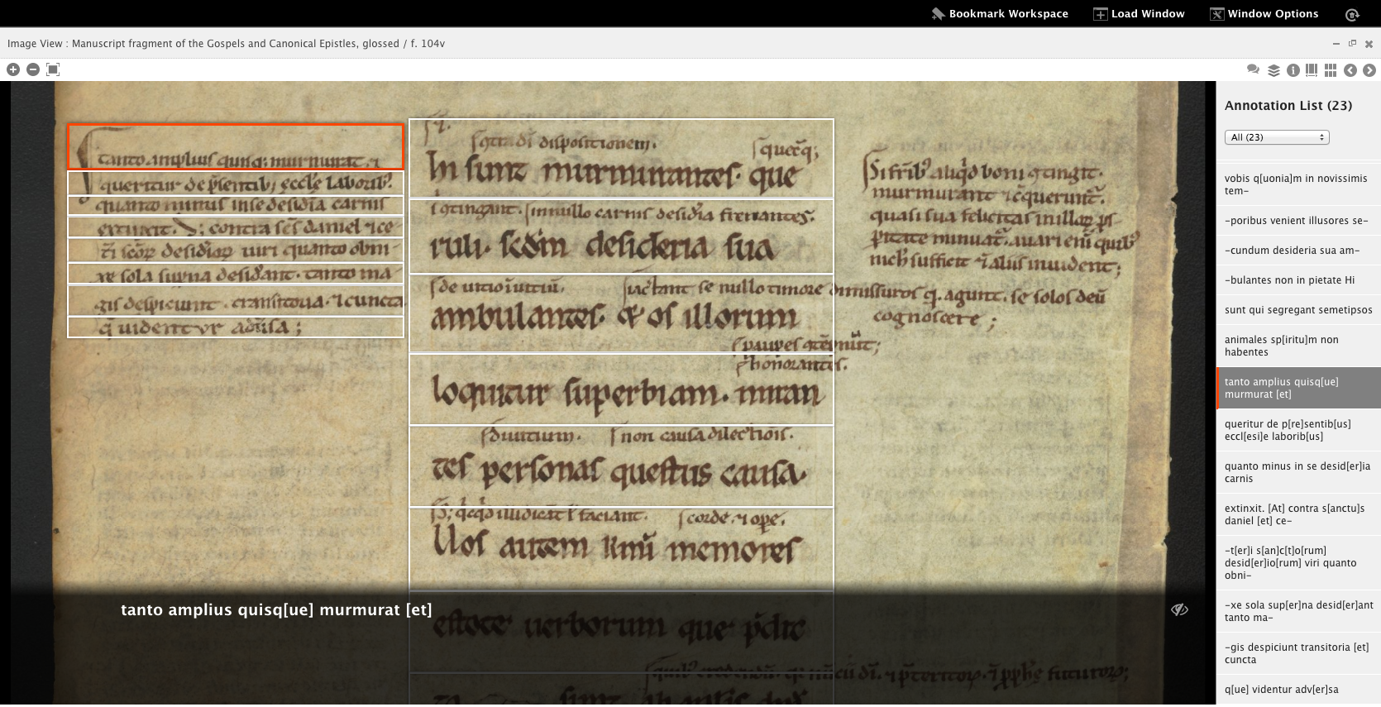
To be used in other contexts…

Slide 37
SharedCanvas: A Data Model

Slide 38
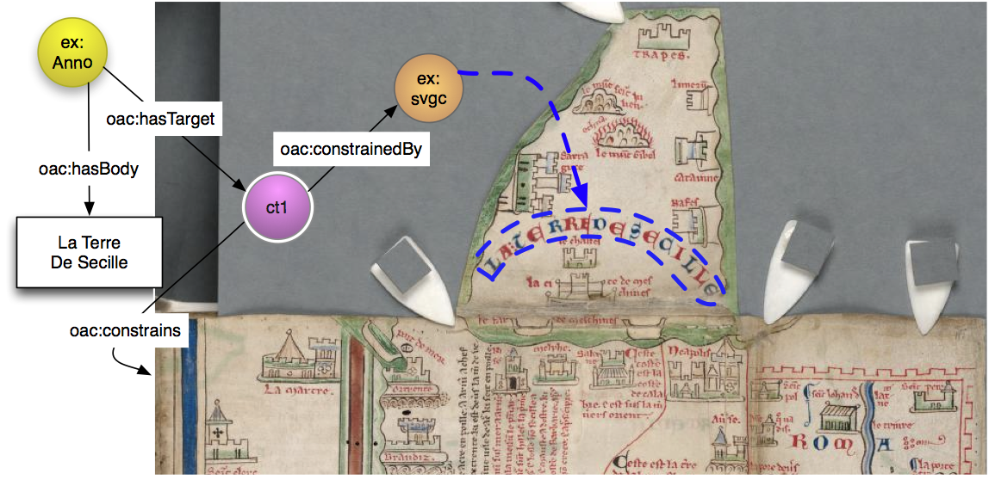

Slide 39
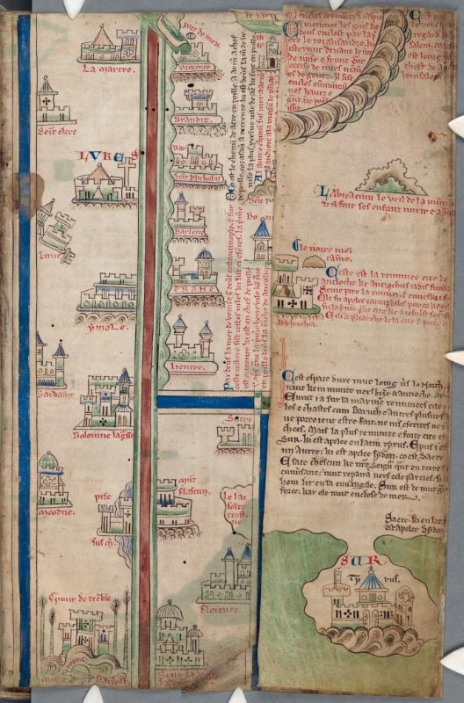
CCC 26 f. iiiR

Slide 40
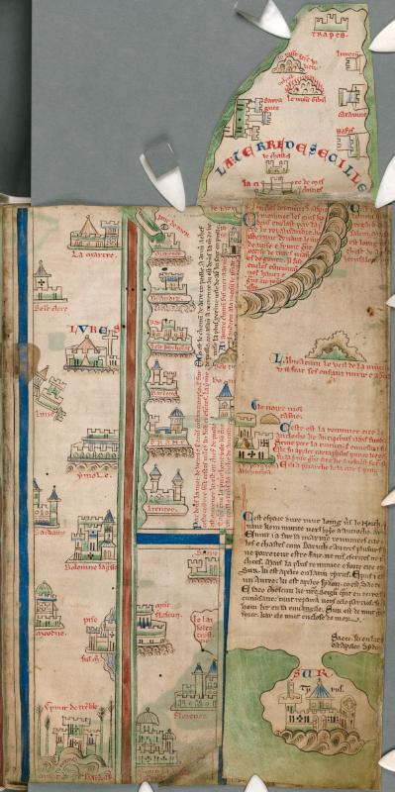
CCC 26 f. iiiR
Fold A Open

Slide 41
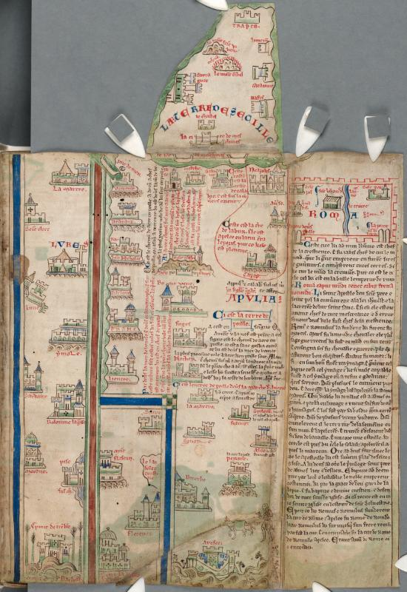
CCC 26 f. iiiR
Fold A Open
Fold A and B Open

Slide 42
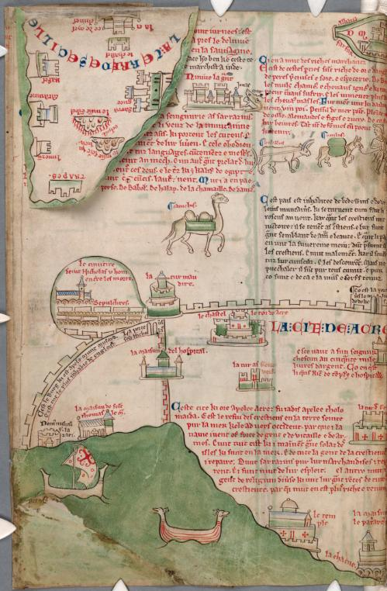
CCC 26 f. iiiR
Fold A Open
Fold A and B Open
f. iiiV

Slide 43
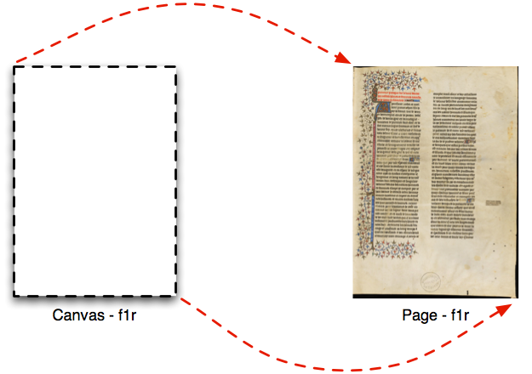

Slide 44
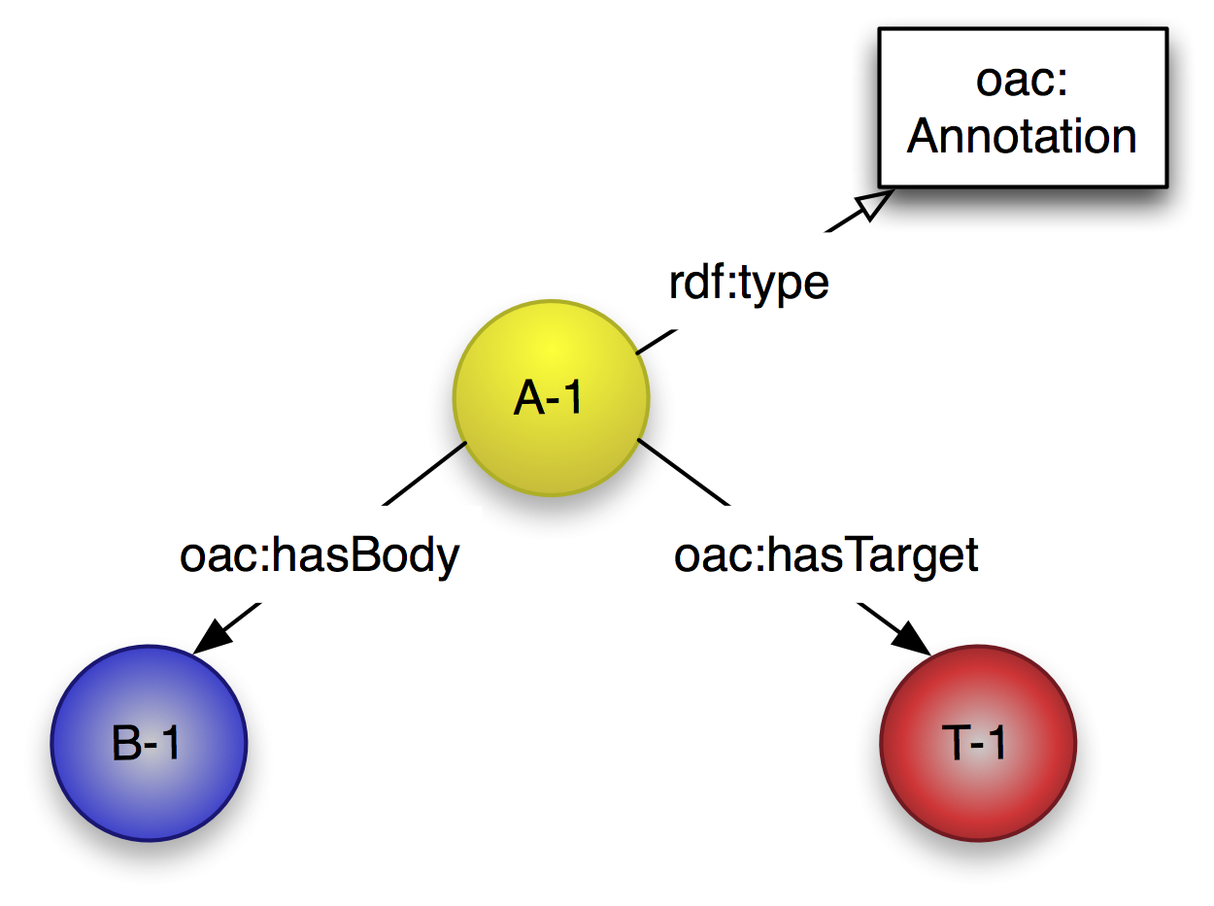

Slide 45
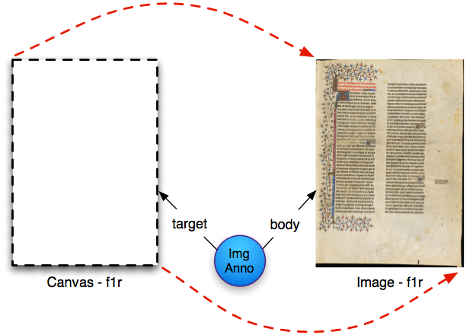

Slide 46
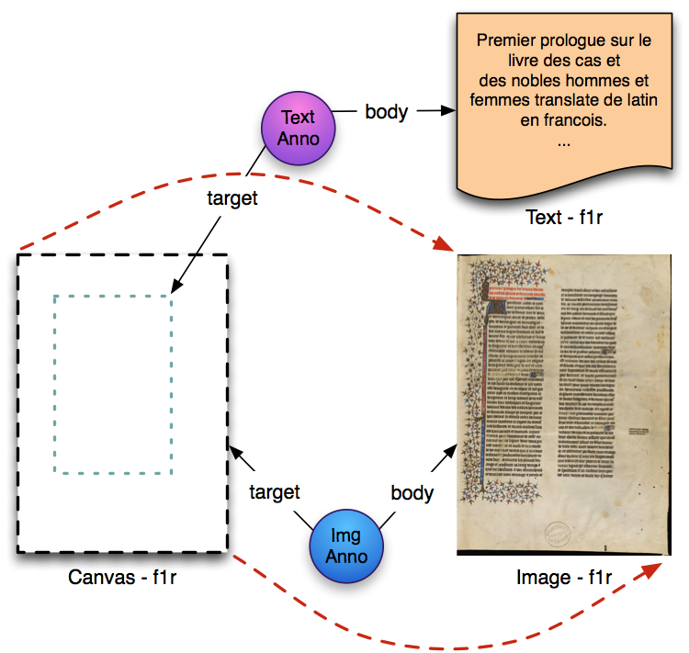

Slide 47
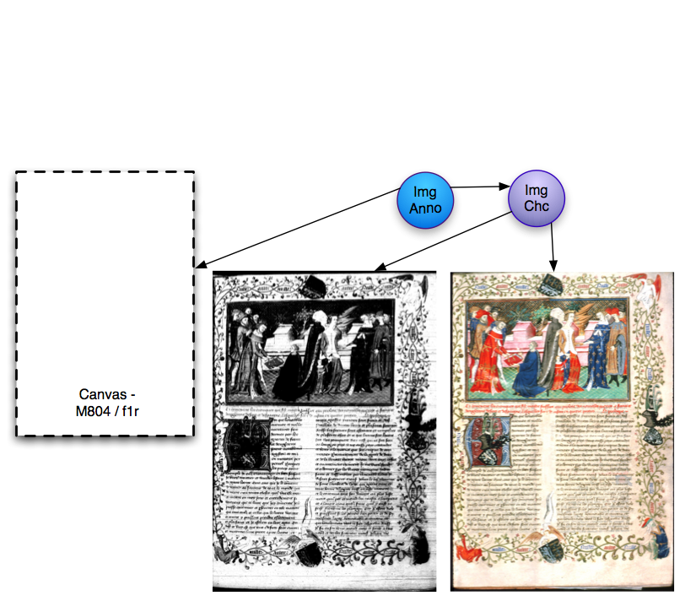

Slide 48
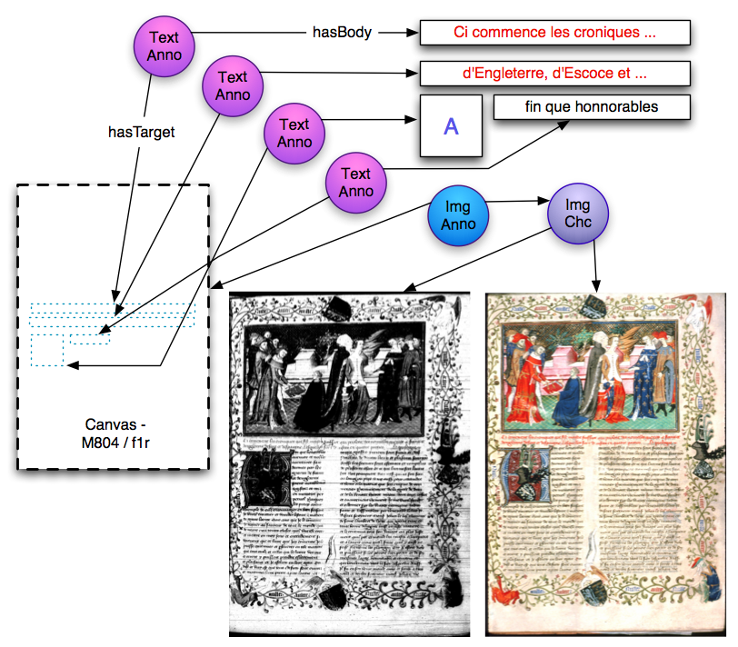

Slide 49
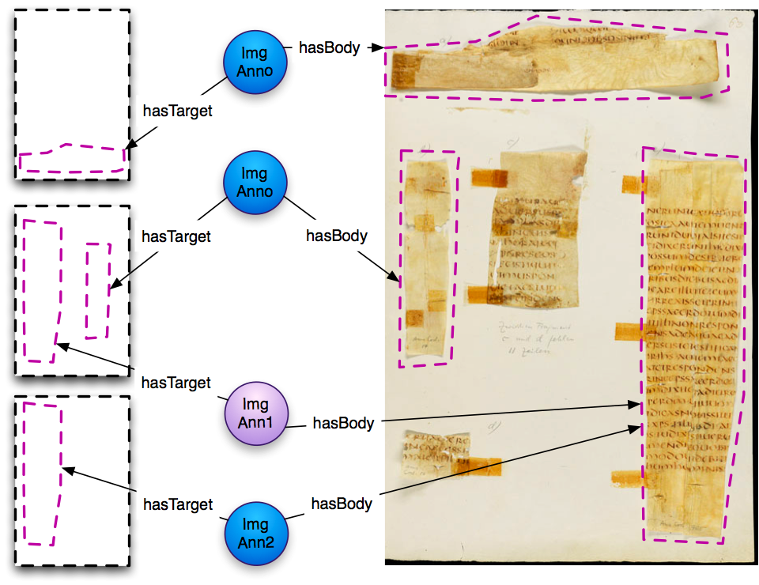

Slide 50
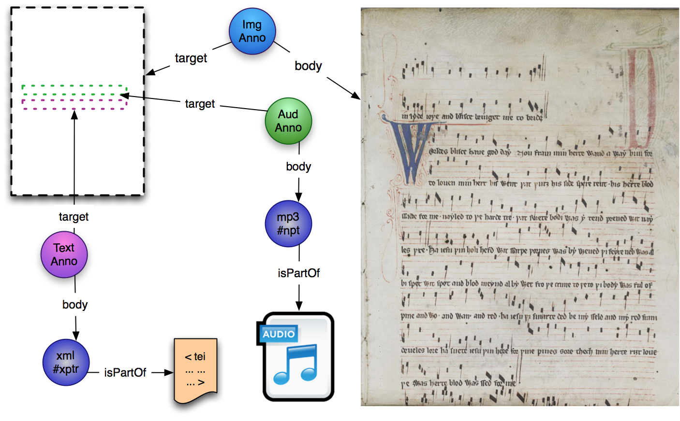

Slide 51
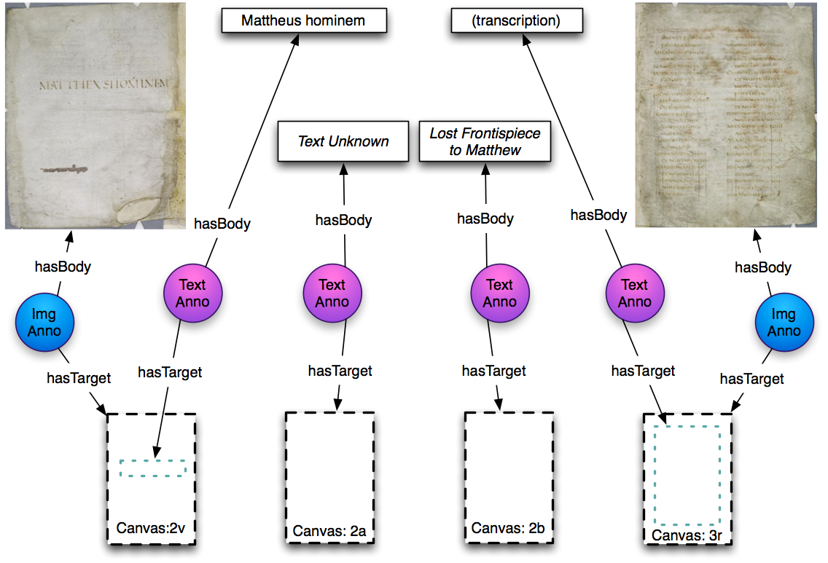

Slide 52
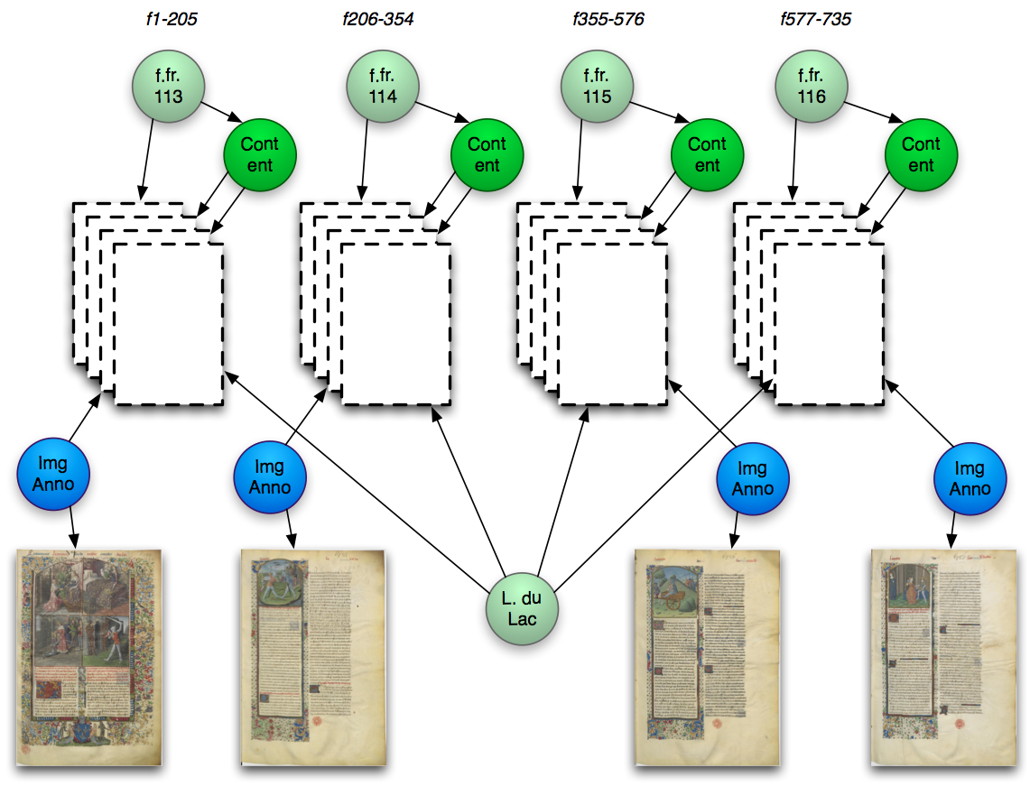

Slide 53
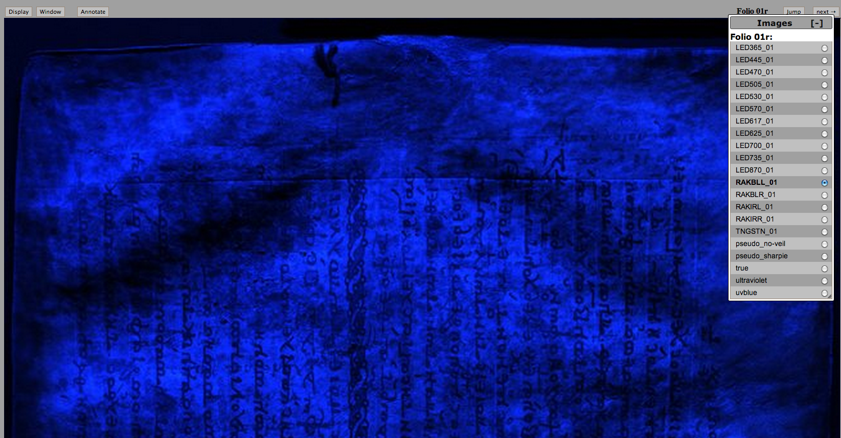
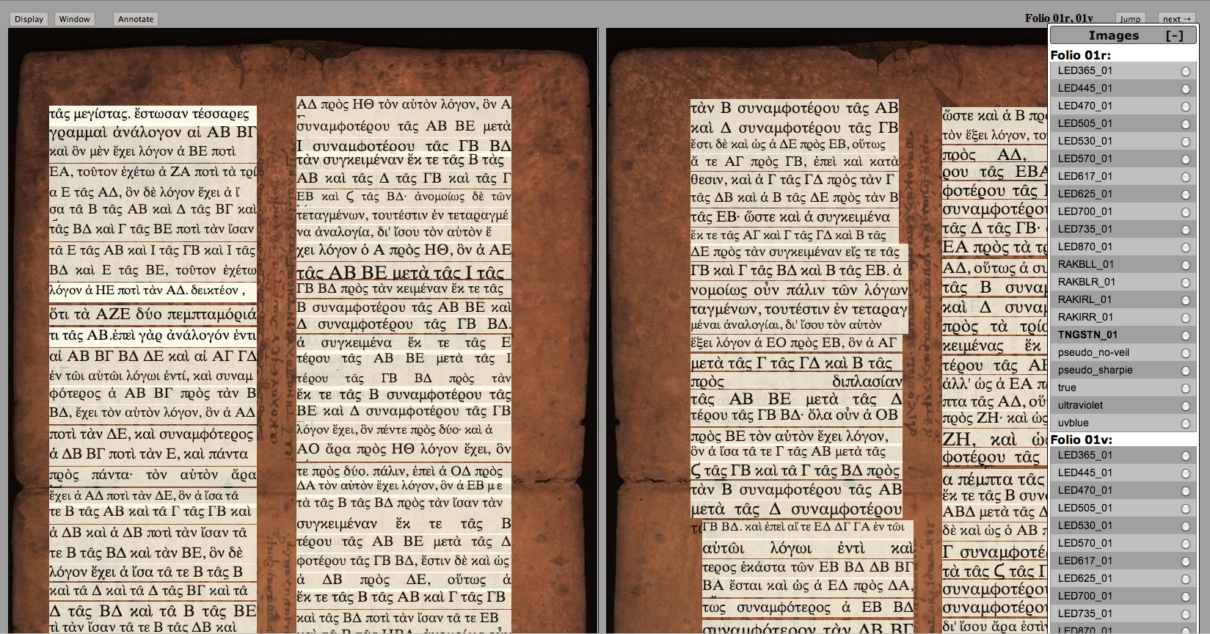
Medieval Manuscripts:
The Complex Use-Case
The Archimedes Palimpsest

Slide 54
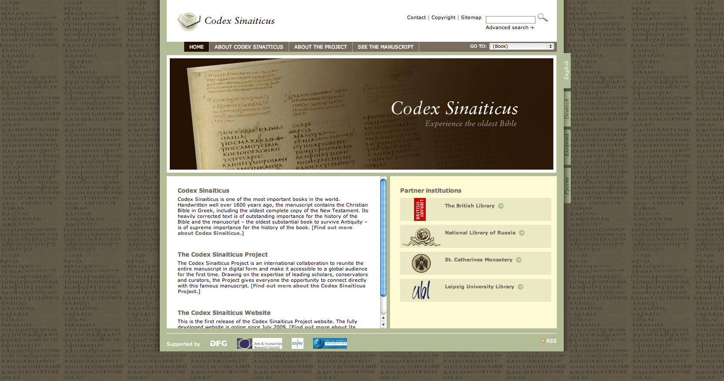
Medieval Manuscripts:
The Complex Use-Case

Slide 55
Medieval Manuscripts:
The Complex Use-Case
This page intentionally,
but unfortunately,
left blank
Countless manuscripts, all around the world!
Notes:
Manuscript fragments
Dispersed leaves

Slide 56
How do we do it?
Represent the physical object in a common data model (SharedCanvas)
Deliver the data via common API (IIIF)

Slide 57
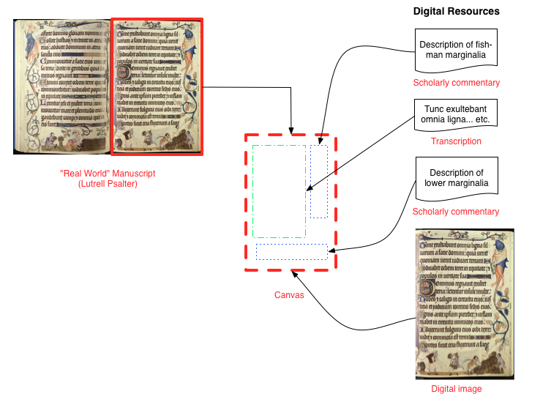
Data Model: SharedCanvas
http://www.shared-canvas.org

Slide 58
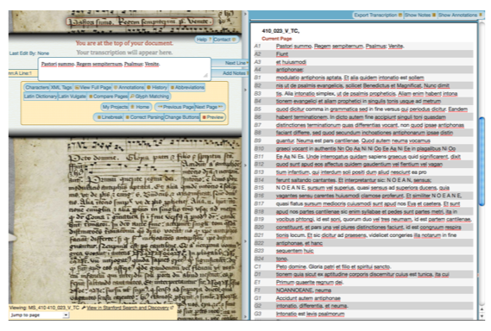
Enable use of third-party tools…
CHMTL text + Parker image in T-PEN
Notes:
New information for existing resources
Line locations on image, line breaks in text

Slide 59


To create useful navigation…

Slide 60

And complex displays
User-generated comments (public and private)
Audio performances of notated music
Overlaid text transcription
Also:
  Data sets
  Mark-up
  Base image choices

Slide 61
How do we do it?
Represent the physical object in a common data model (SharedCanvas)
Deliver the data via common API (IIIF)

Slide 62

Deliver via API: IIIF
http://library.stanford.edu/iiif/image-api

Slide 63

Introducing… Mirador

Slide 64
Introducing… Mirador “A Viewer”

Slide 65

With transcription viewing

Slide 66

UI “in progress”

Slide 67

Recto and Verso

Slide 68

Comparison across MSS.

Slide 69

Light-Weight Annotation

Slide 70

Light-Weight Annotation

Slide 71
IIIF Vision
Create a global framework by which image-based resources (images, books, maps, scrolls, manuscripts, musical scores, etc.)
…from any participating institution can be
delivered in a standard way
…via any compatible image server
…for display, manipulation and
annotation in any application,
…to any user on the Web,
…in any combination of elements.

Slide 72
IIIF Participants
ARTstor
Biblissima
Bodleian Libraries, Oxford University
British Library
Cambridge University
Cornell University
DPLA
Europeana
Harvard University
Johns Hopkins University
le Louvre
National Library of Denmark
National Library of Norway
National Library of Wales
Princeton University
St. Louis University, TPEN
Stanford University
Wellcome Trust
Yale University

Slide 73
IIIF Objectives
Define APIs for
  Image Delivery
  Metadata (to drive image presentation)
Recruit repositories for API adoption
Catalyze software development
  Zoomers, Viewers, Page Turners, Anno tools
  Really fast, really slippy image delivery
Establish an ongoing effort

Slide 74
Looking Forward
“Search Within” API
Annotation API
Discovery of IIIF-compatible Resources
Adoption and Expansion
  Repositories & Software Developers
  Content!
  Connect!
    http://iiif.io
    IIIF-Discuss@googlegroups.com

